Slide 1
LACE Score Proposal
OHSU BMI 596 Analytics On Campus Aug 2017
Julian Egger
Matthias Kochmann

Slide 2

Notes:
In the 21st century the healthcare system is taking care of a population of people.
New government mandates like the MACRA (Medicare Access and CHIP Reauthorization Act) place harder restrictions on care for this population
One of them is the penalty for readmission
- Currently up to 3% of penalty
Prevention of admissions is resource intensive for your healthcare system
The question is how to most efficiently allocated the resources
Prior questions
How do you identify a person at risk
Current status
Doctors gut feeling
Target status
Precise, objective , measurement

Slide 3
Problem:
No objective judgement
No best practice
No plan for improvement
Notes:
Impact of no change
Increasing trend of admission
Need to be able to reduce it again
Problem
No plan to improve it

Slide 4
L.A.C.E Score
28 %
3.7 %
67%
Notes:
Introduce the solution:
Advanced analytics using machine learning techniques
Objective percentage score for each admitted patient

Slide 5
Points
L
Length of Stay
A
Acuity of Admission
C
Comorbidities
E
Emergent department visit
Total =
Notes:
Length of stay in as score not real dates

Slide 6
Points
L
Length of Stay
4
A
Acuity of Admission
3
C
Comorbidities
6
E
Emergent department visit
4
Total =
17
High Risk
Notes:
Set the stage : Make sure to summarize !
Why do we need to change?
Impact of not changing
Introduce solution
Go inside the solution
Relate to the Organization
Audience's role / sponsorship and Next steps

Slide 7
Ottawa Hospital Research Institute LACE Index Scoring Tool for Risk Assessment of Death and Readmission¹
Developed in 2010
External validated scoring mechanism
Stratifies each patient individually based on their medical condition into three categories
¹ van Walraven, Carl, et al. "Derivation and validation of an index to predict early death or unplanned readmission after discharge from hospital to the community." Canadian Medical Association Journal 182.6 (2010): 551-557
Notes:
Logistic regression model
LACE score and other patient features
Set the stage : Make sure to summarize !
Why do we need to change?
Impact of not changing
Introduce solution
Go inside the solution
Relate to the Organization
Audience's role / sponsorship and Next steps

Slide 8
Predictive Modeling of LACE Score applied to IU Health
Original LACE Score Threshold for High Risk
Test set subsampled from 34,532 patients classified as either readmit or non-readmit under 30 days
22,273 diagnosed with congestive heart failure
6,751 labeled as high risk (LACE)
8,760 diagnosed with 8,760 coronary artery disease
2,896 labeled as high risk (LACE)
Accuracy: 73%
Sensitivity: 88%
Specificity: 26%
Notes:
We used a test set of patients from IU Health
Validated the LACE score and and then a LACE score with other patient characteristic using logistic regression
Results is the accuracy
Congestive Heart Failure
Coronary artery disease
Original LACE score used threshold of 11

Slide 9
Predictive Modeling of LACE Score applied to IU Health
Original LACE Score Threshold for High Risk
Can we improve our classifications utilizing LACE score?
Accuracy: 73%
Sensitivity: 88%
Specificity: 26%
Notes:
We used a test set of patients from IU Health
Validated the LACE score and and then a LACE score with other patient characteristic using logistic regression
Results is the accuracy
Congestive Heart Failure
Coronary artery disease
Original LACE score used threshold of 11

Slide 10
Predictive Modeling of LACE Score applied to IU Health
Original LACE Score Threshold for High Risk
Modified LACE With Logistic Regression Model
Accuracy: 73%
Accuracy: 85%
Sensitivity: 88%
Sensitivity: 85%
Specificity: 26%
Specificity: 54%
Notes:
We used a test set of patients from IU Health
Validated the LACE score and and then a LACE score with other patient characteristic using logistic regression
Results is the accuracy
Congestive Heart Failure
Coronary artery disease
Original LACE score used threshold of 11

Slide 11
Estimated savings for IU Health using Modified LACE Score
 | Number of Pt. | LACE High Risk Patients For Readmission |  | Preventing 20% of unneeded readmissions
Total | 34,532
Congestive Heart Failure | 22,273 | 6,751 |  | 1,350
Coronary Artery Disease | 8,760 | 2,896 |  | 579

Slide 12
Conclusion
Preventing unnecessary readmissions is a key factor to prevent CMS penalties
The LACE score can identify patients at risk of readmission with in the next 30 days.
Using machine learning techniques we are able to improve the predictive accuracy of the LACE score

Slide 13
Next Steps
Improve cost saving by improving the model with :
More comorbidities
Larger cohort
2. Testing the model in a pilot project at one hospital
3. Performing a validation and cost saving analysis of the pilot
Notes:
Set the stage : Make sure to summarize !
Why do we need to change?
Impact of not changing
Introduce solution
Go inside the solution
Relate to the Organization
Audience's role / sponsorship and Next steps

Slide 14
Questions
Notes:
Set the stage : Make sure to summarize !
Why do we need to change?
Impact of not changing
Introduce solution
Go inside the solution
Relate to the Organization
Audience's role / sponsorship and Next steps

Slide 15
Notes:
Set the stage : Make sure to summarize !
Why do we need to change?
Impact of not changing
Introduce solution
Go inside the solution
Relate to the Organization
Audience's role / sponsorship and Next steps

Slide 16
L
A
C
Congestive Heart Failure
Previous Myocardial Infarction
E
AUC: 61%
Accuracy: 83%

Slide 17
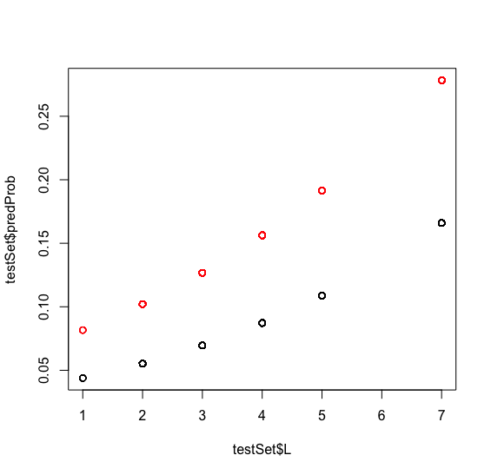
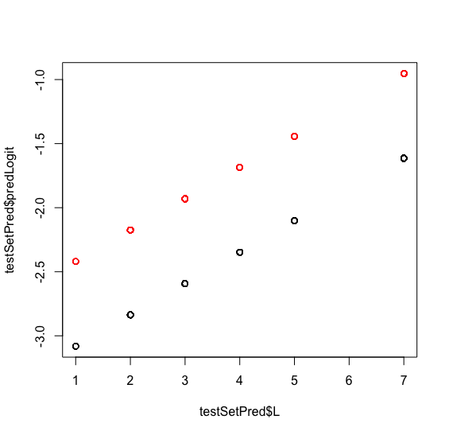
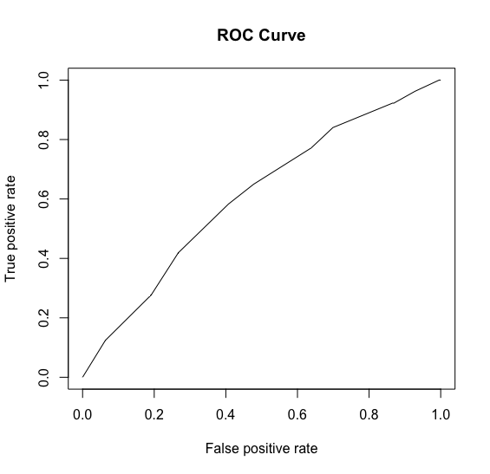
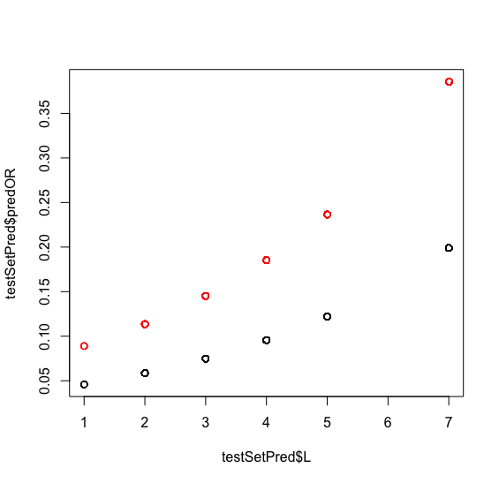
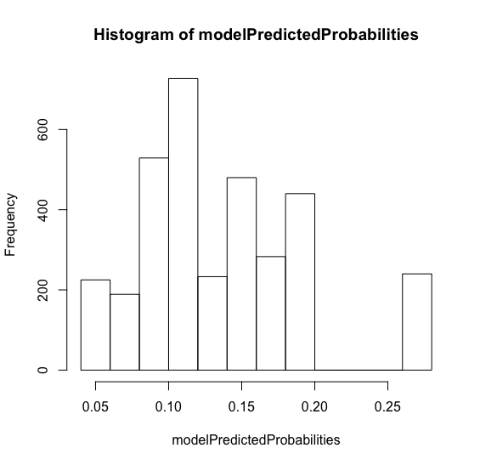

Slide 18
Implementation
Why should it be implemented
Pitfalls for implementation
The model itself
Organizational perspective

Slide 19
Set the stage
Impact of not changing
Introducing the solution
High level
Explain how the solution will be used
Explain impact
Build active engagement
Call to action

